Slide 1
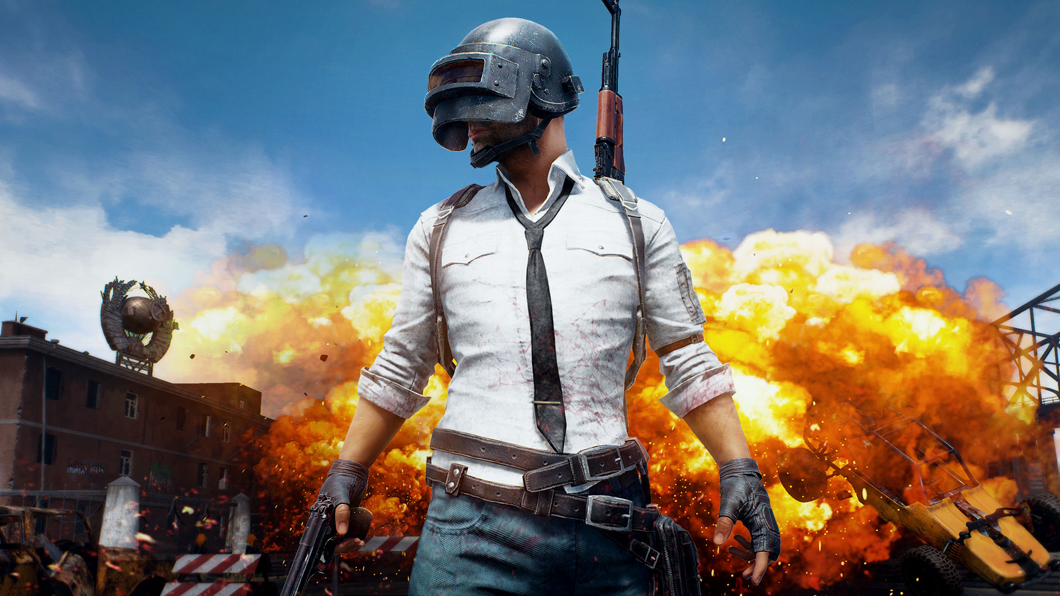
Winner Winner, Chicken Dinner! How to win in PUBG? Don't be too cautious! Walk around and find someone to fight! :)

Slide 2
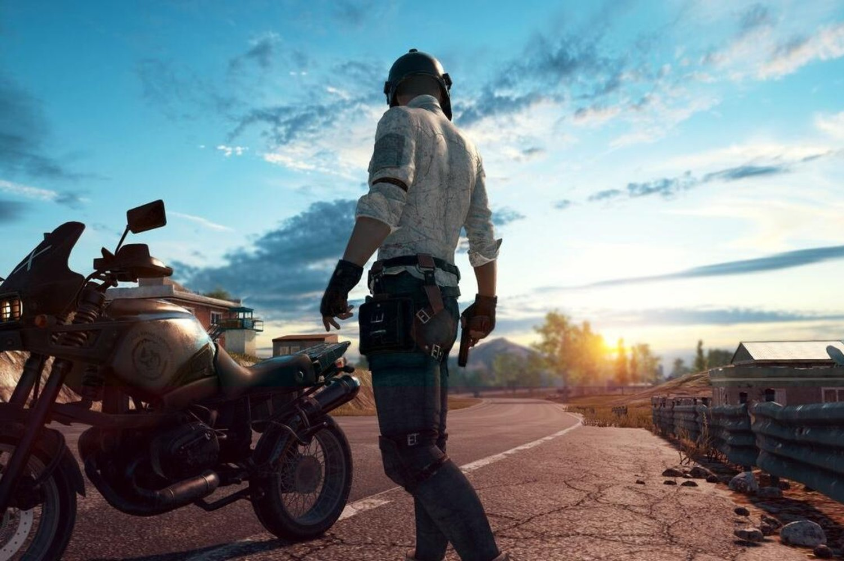
Introduction What's the best strategy to win in PUBG? Should you sit in one spot and hide your way into victory, or do you need to be the top shot? This is what we are looking into!

Slide 3
How We Built It
We used a large data set which has about 18,000 pieces of data to train our regression model. We first used PCA to extract the main contributors of winning the game. They are: walk distance, kill place, weapons acquired, ride distance, and boosts.
Then we used these variables to run multi-variable regression. We Preprocessed data with Python and doing regression analysis with SPSS.

Slide 4
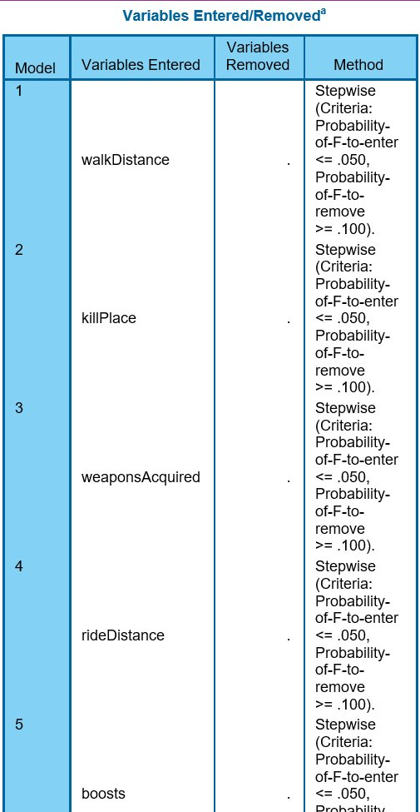
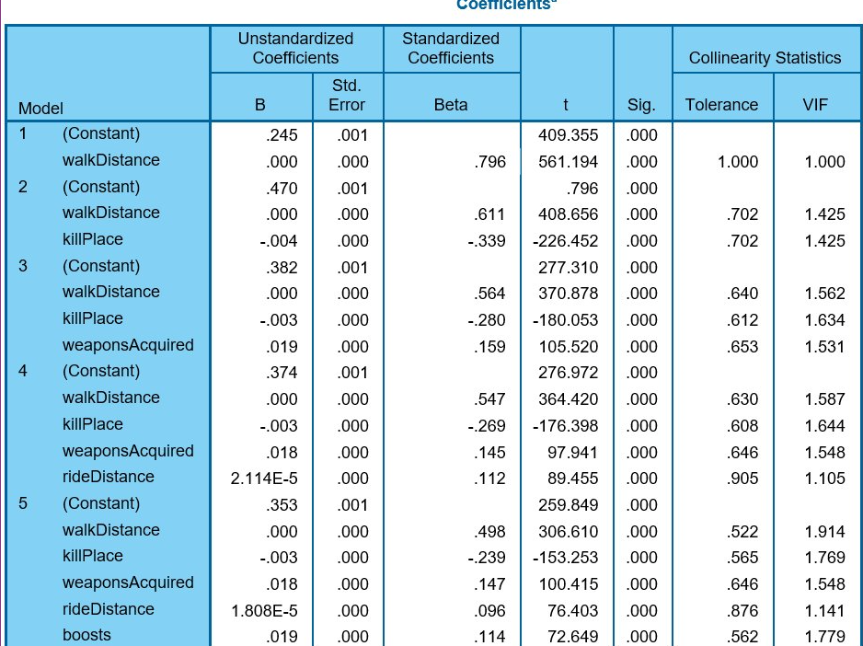

Slide 5
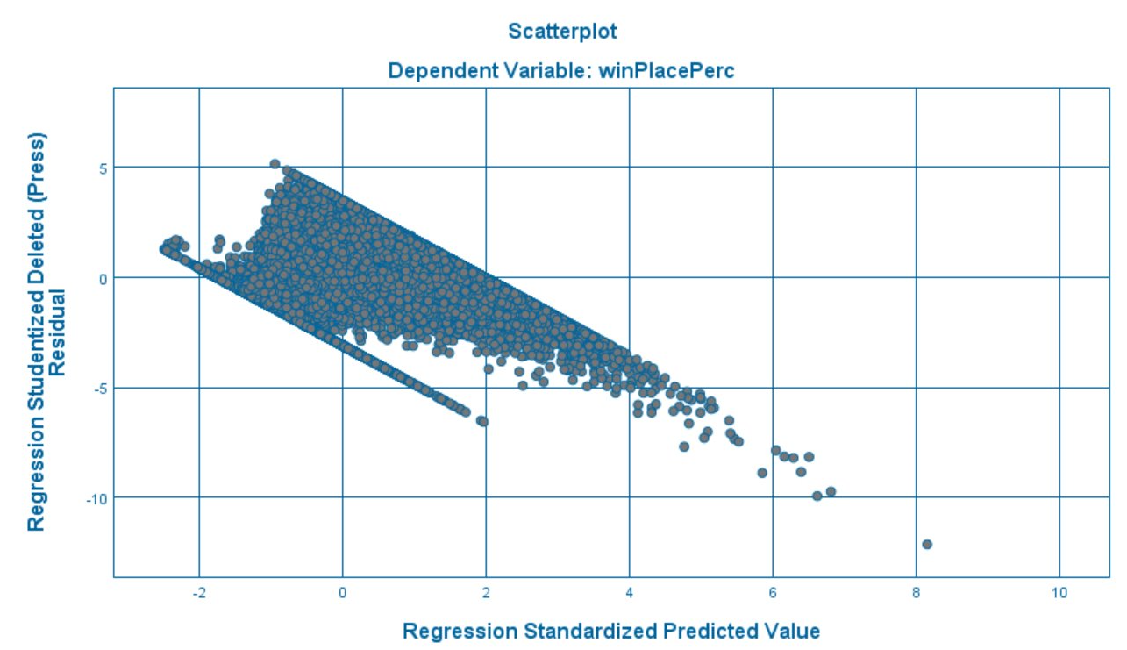
winPlacePerc = .498 * walkDistance - .239 * killPlace + .147 * weaponsAcquired + .096 * rideDistance + .114 * boosts.

Slide 6
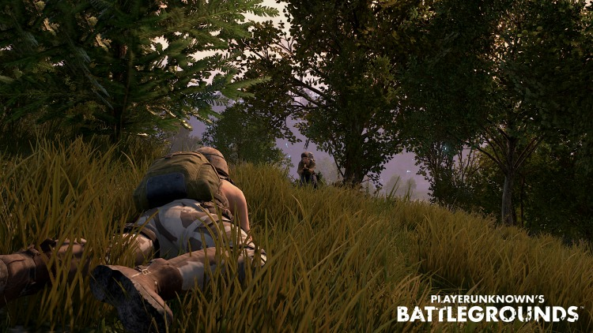
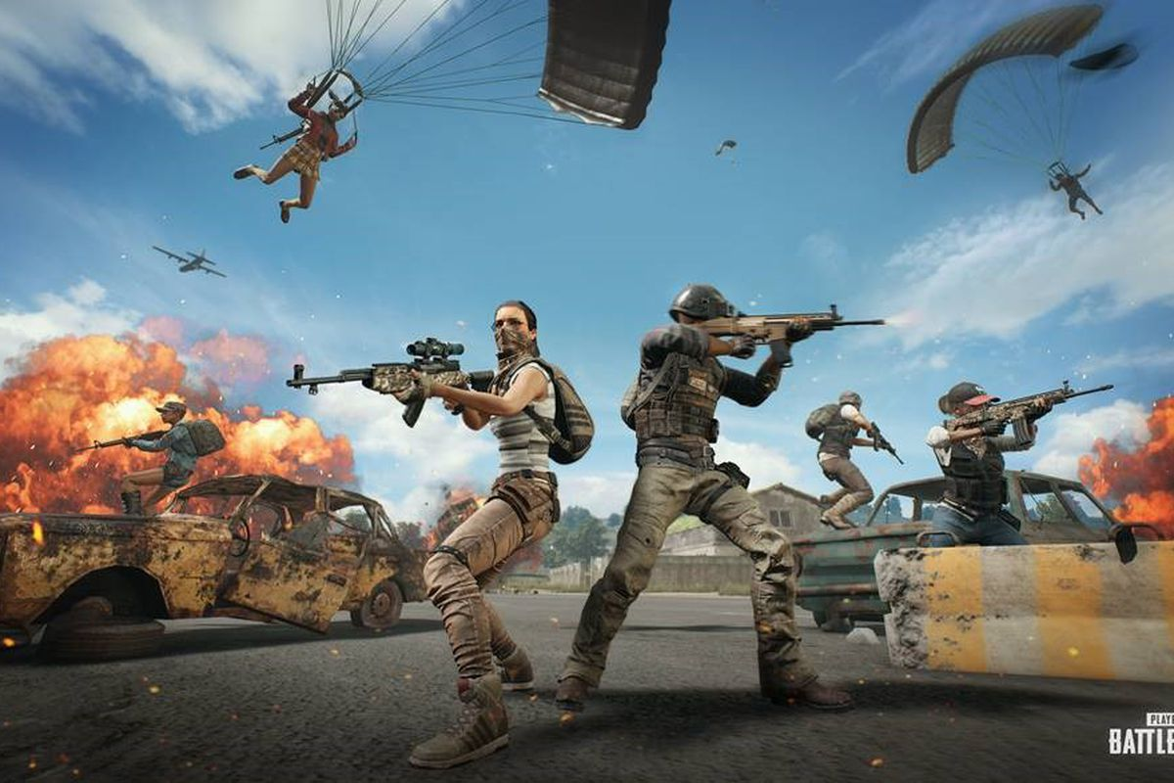
It analyzes which independent variables have the most weight in determining finishing placement, and generates corresponding regression equation: winPlacePerc = .498 * walkDistance - .239 * killPlace + .147 * weaponsAcquired + .096 * rideDistance + .114 * boosts. So, don't be too cautious! Walk around and find someone to fight:)
Conclusion

Slide 7

Thank you!

